Slide 1


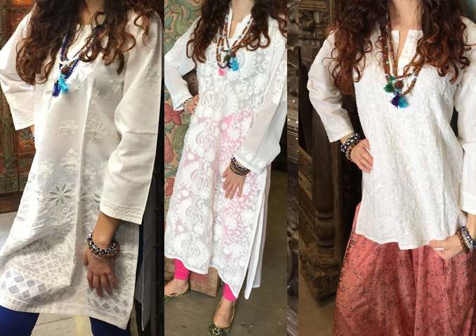
Bohème Vibe Gypsy Fashion
MOGUL INTERIOR 19451 S. TAMIAMI TRAIL, SUITE 110 FT MYERS, FLORIDA 33908
239-603-7777 mogulinterior@aol.com

Slide 2
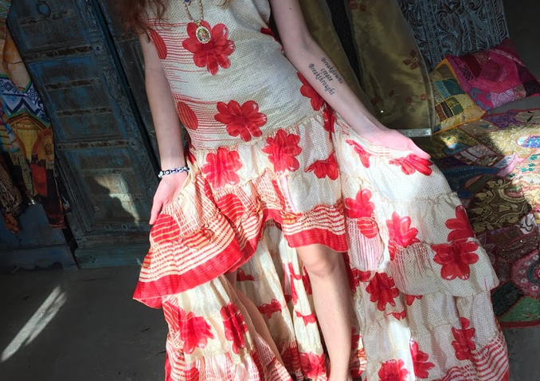
Bohème Vibe Gypsy Fashion
MOGUL INTERIOR 19451 S. TAMIAMI TRAIL, SUITE 110 FT MYERS, FLORIDA 33908
239-603-7777 mogulinterior@aol.com

Slide 3
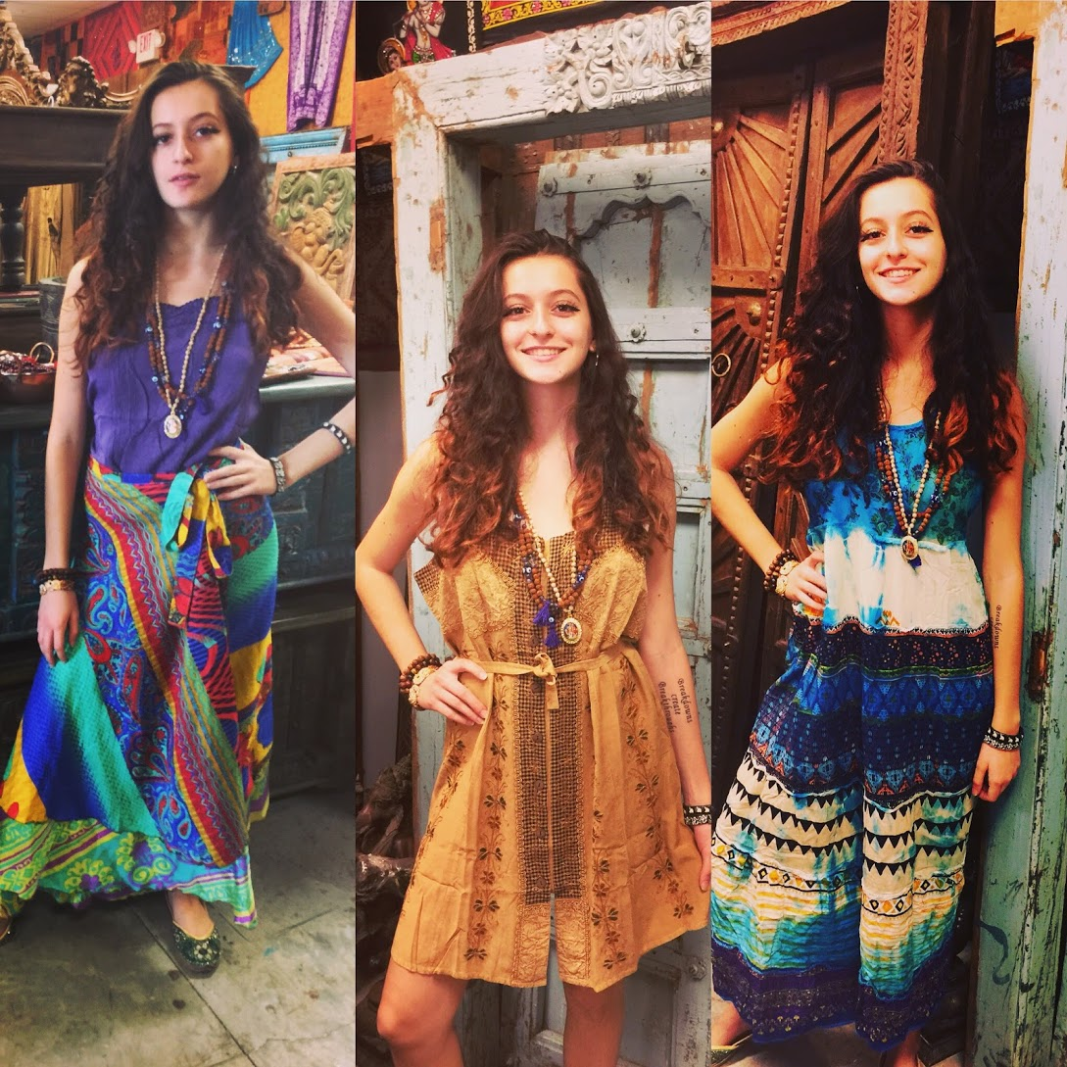
Bohème Vibe Gypsy Fashion
MOGUL INTERIOR 19451 S. TAMIAMI TRAIL, SUITE 110 FT MYERS, FLORIDA 33908
239-603-7777 mogulinterior@aol.com

Slide 4
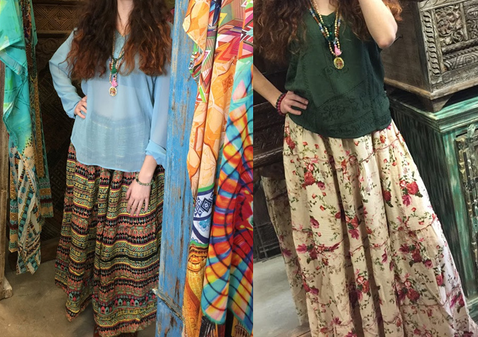
Bohème Vibe Gypsy Fashion
MOGUL INTERIOR 19451 S. TAMIAMI TRAIL, SUITE 110 FT MYERS, FLORIDA 33908
239-603-7777 mogulinterior@aol.com

Slide 5
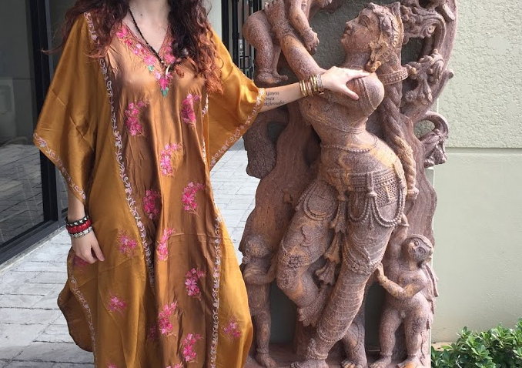
Bohème Vibe Gypsy Fashion
MOGUL INTERIOR 19451 S. TAMIAMI TRAIL, SUITE 110 FT MYERS, FLORIDA 33908
239-603-7777 mogulinterior@aol.com

Slide 6
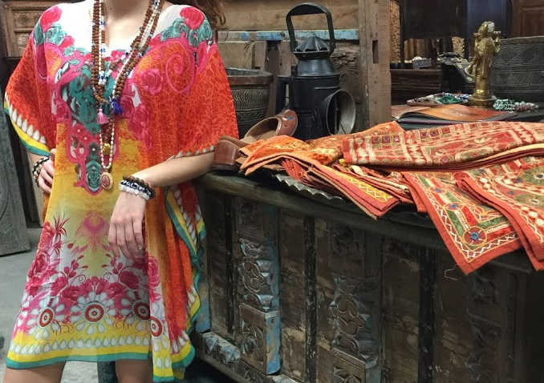
Bohème Vibe Gypsy Fashion
MOGUL INTERIOR 19451 S. TAMIAMI TRAIL, SUITE 110 FT MYERS, FLORIDA 33908
239-603-7777 mogulinterior@aol.com

Slide 7
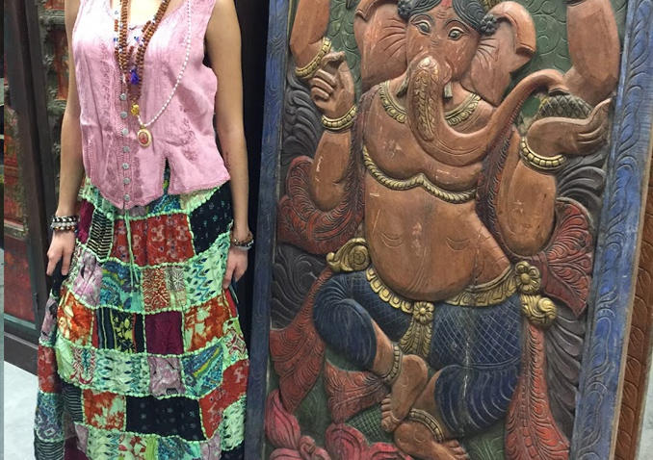
Bohème Vibe Gypsy Fashion
MOGUL INTERIOR 19451 S. TAMIAMI TRAIL, SUITE 110 FT MYERS, FLORIDA 33908
239-603-7777 mogulinterior@aol.com

Slide 8
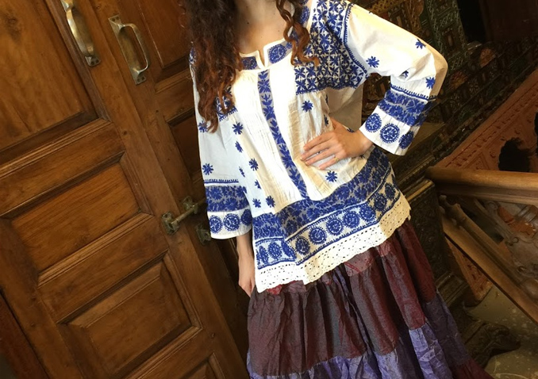
Bohème Vibe Gypsy Fashion
MOGUL INTERIOR 19451 S. TAMIAMI TRAIL, SUITE 110 FT MYERS, FLORIDA 33908
239-603-7777 mogulinterior@aol.com

Slide 9
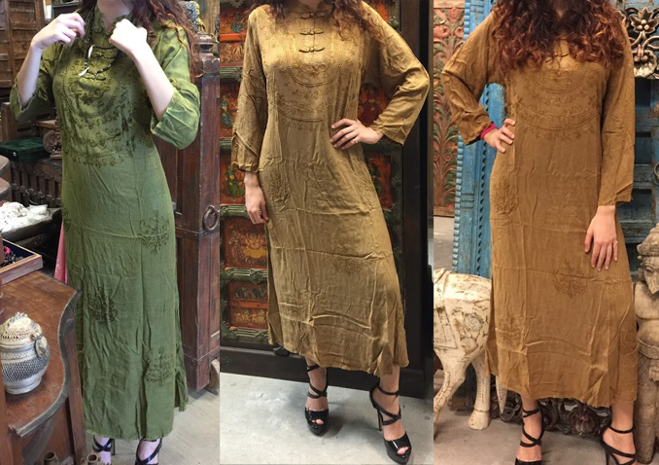
Bohème Vibe Gypsy Fashion
MOGUL INTERIOR 19451 S. TAMIAMI TRAIL, SUITE 110 FT MYERS, FLORIDA 33908
239-603-7777 mogulinterior@aol.com

